Slide 1
GitHub - DesignHub
Team 4 – Matthew Tice, Mateo Terselich, Agil Madinali, Mingming Qiu, Jessica Thomas, Cesar Santana, Zixian Yang

Slide 2
Log-in Information
Database
Database link: https://github.com/aristehub
username/email: aristehub@gmail.com
password: cs691@Pace
CS 691 - Webpage link: https://www.DesignHub.com
CS 692 - Shopping section link: https://www.DesignHub.com

Slide 3
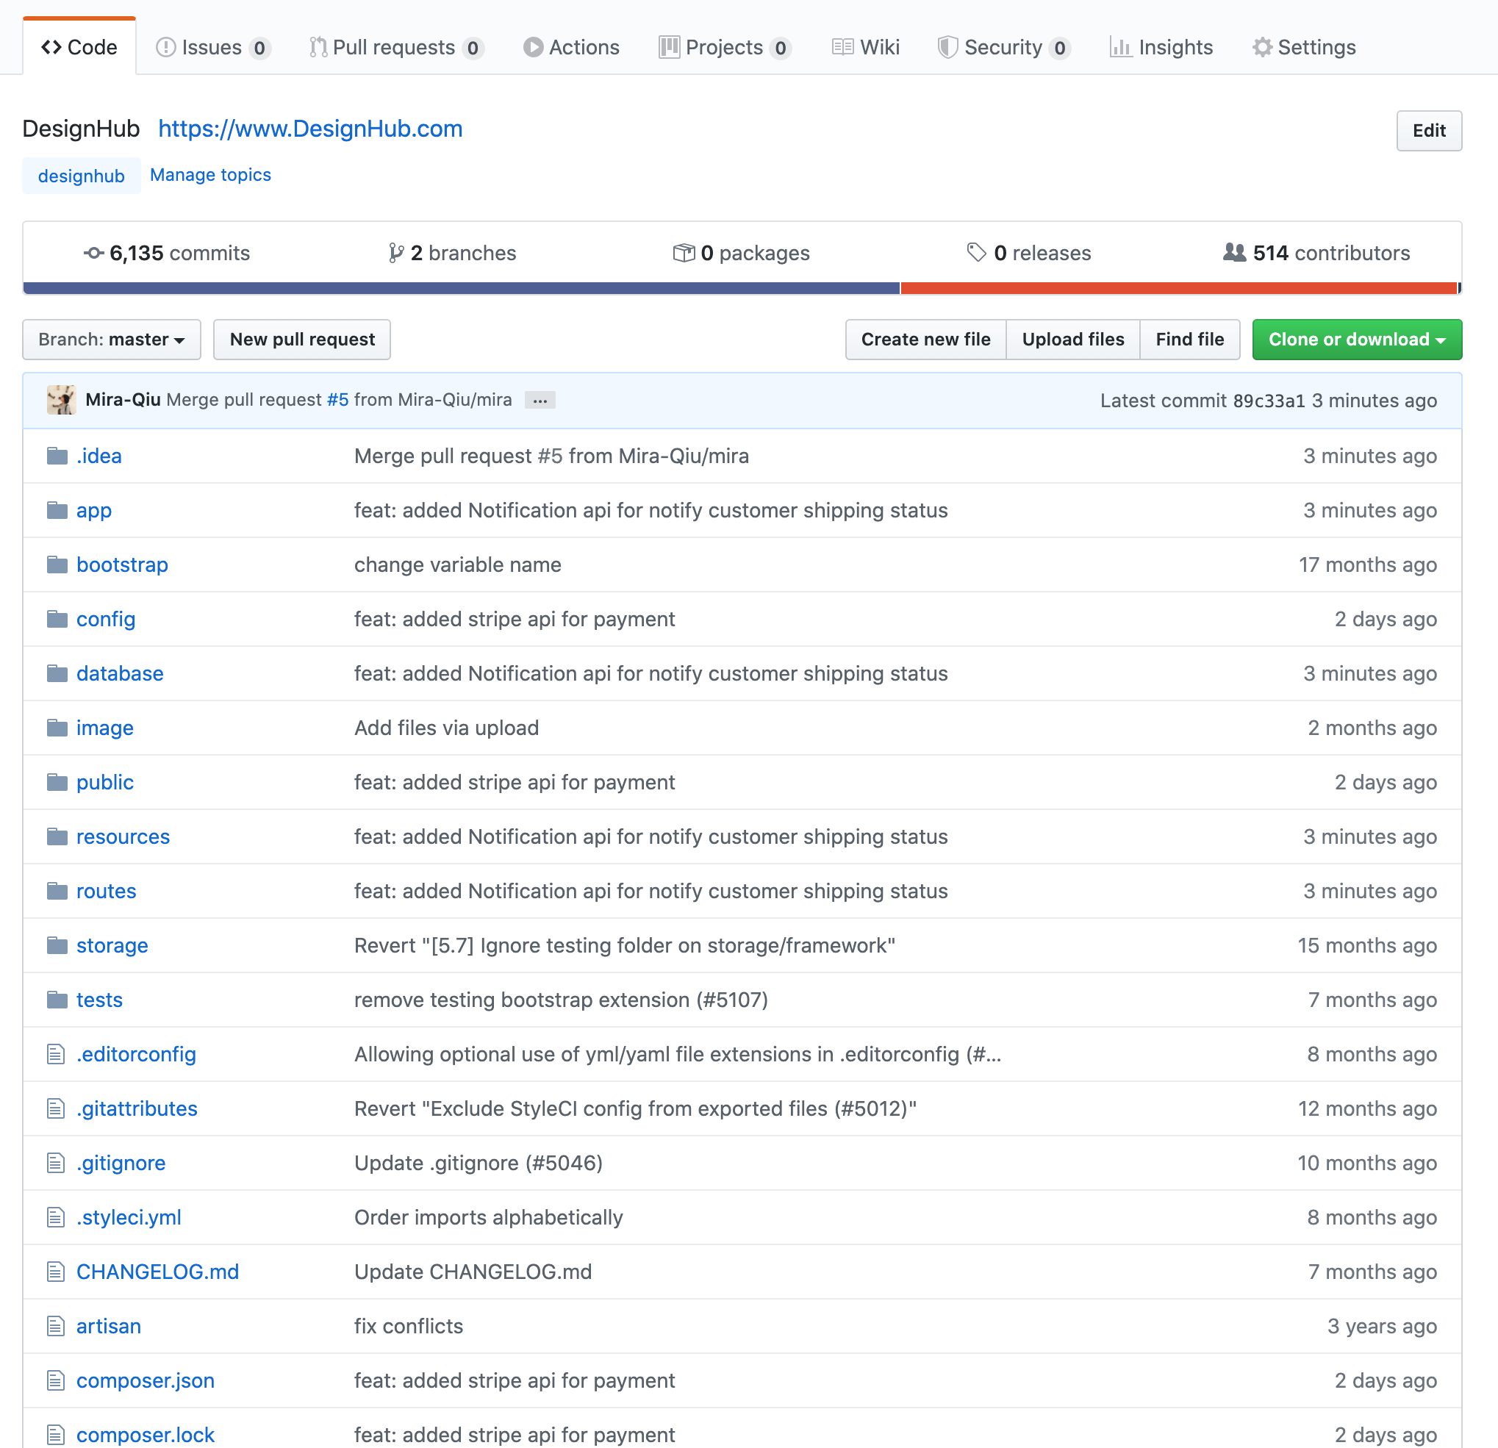
Repository Structure

Slide 4
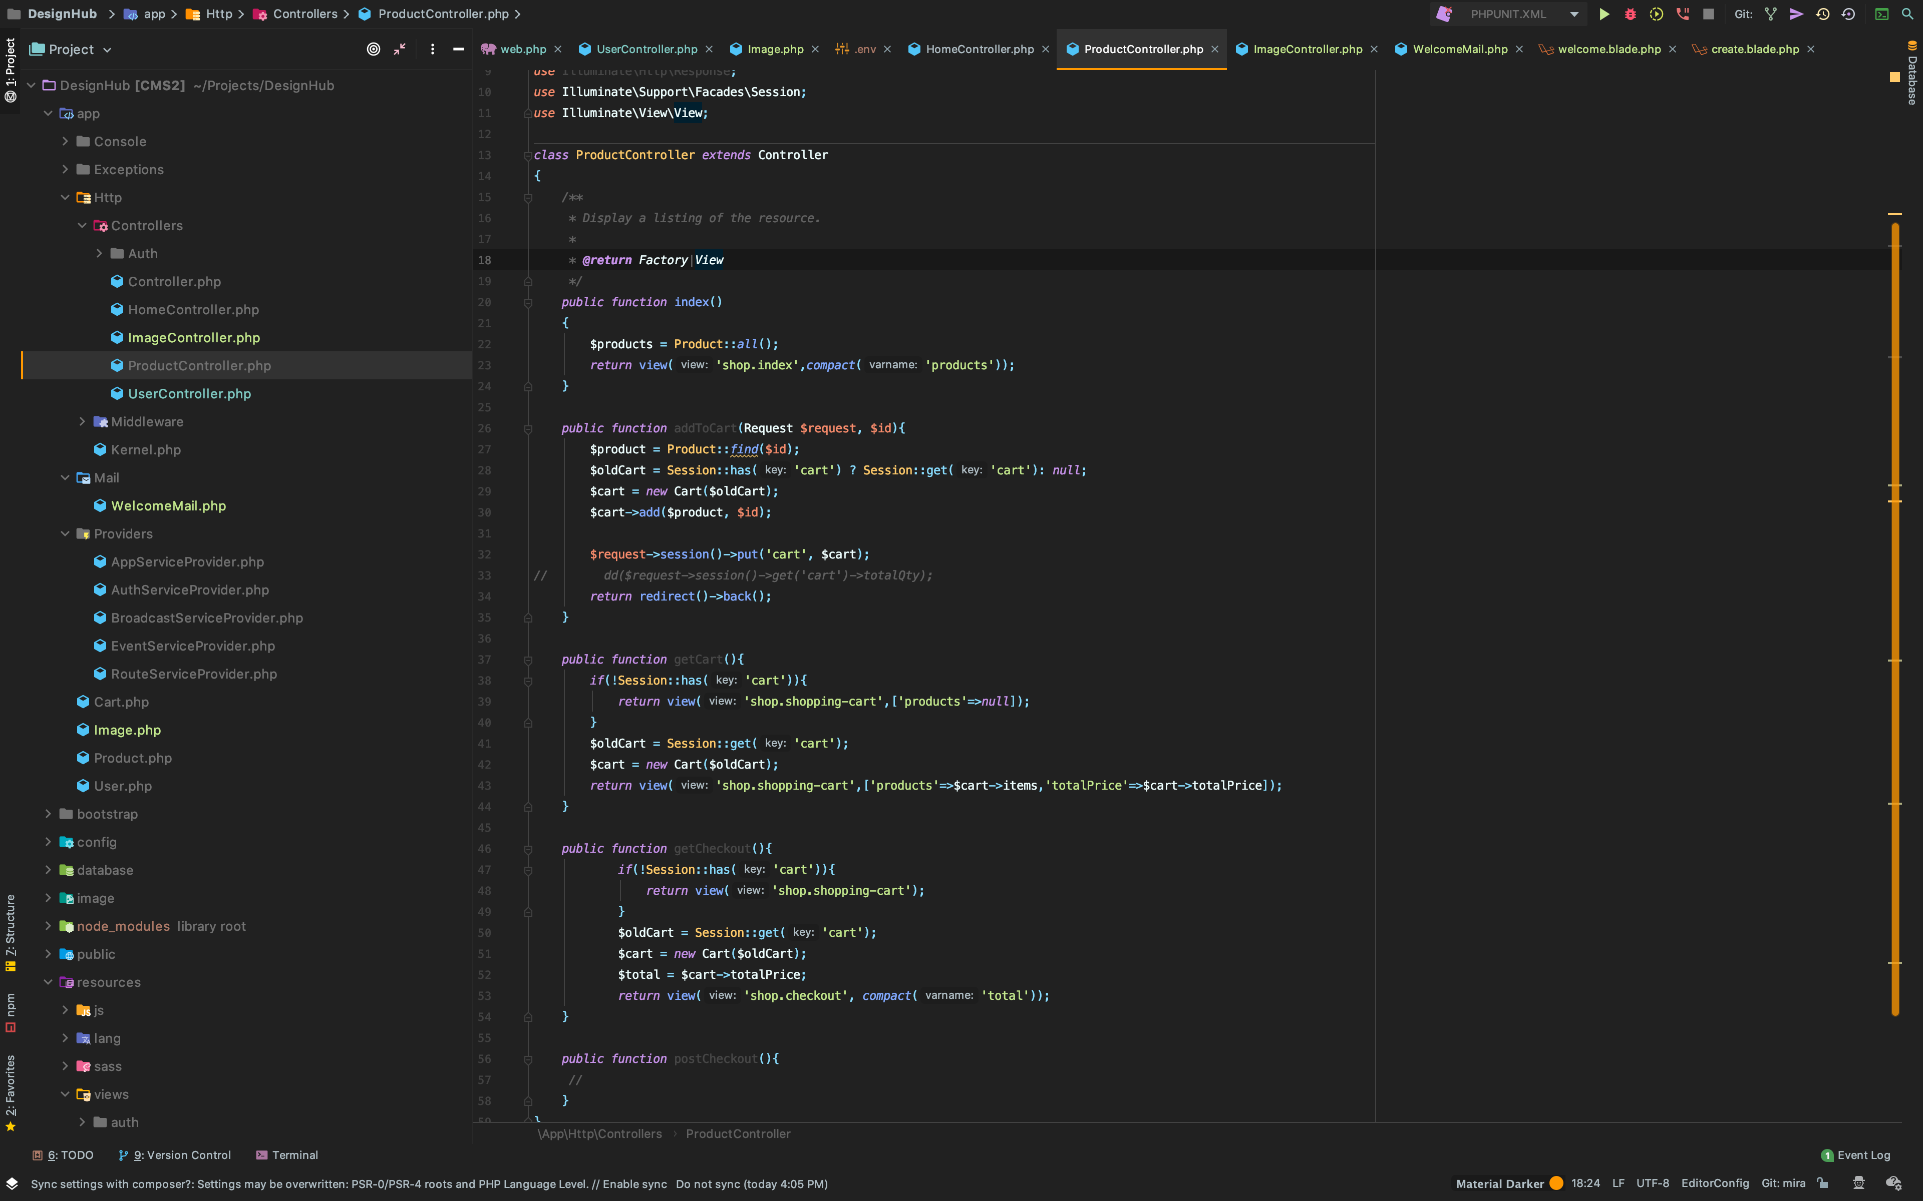
Source Code for Application – ProductController

Slide 5
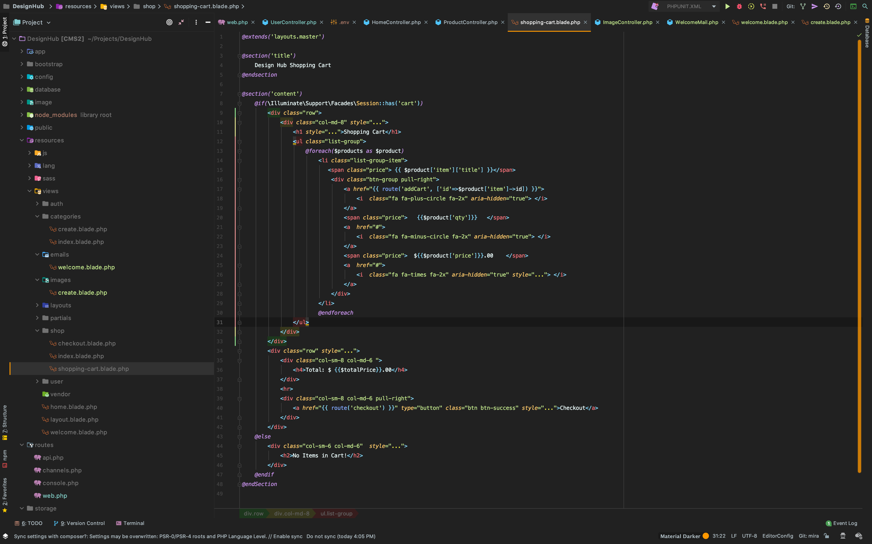
Source Code for Application – Shopping-cart view

Slide 6
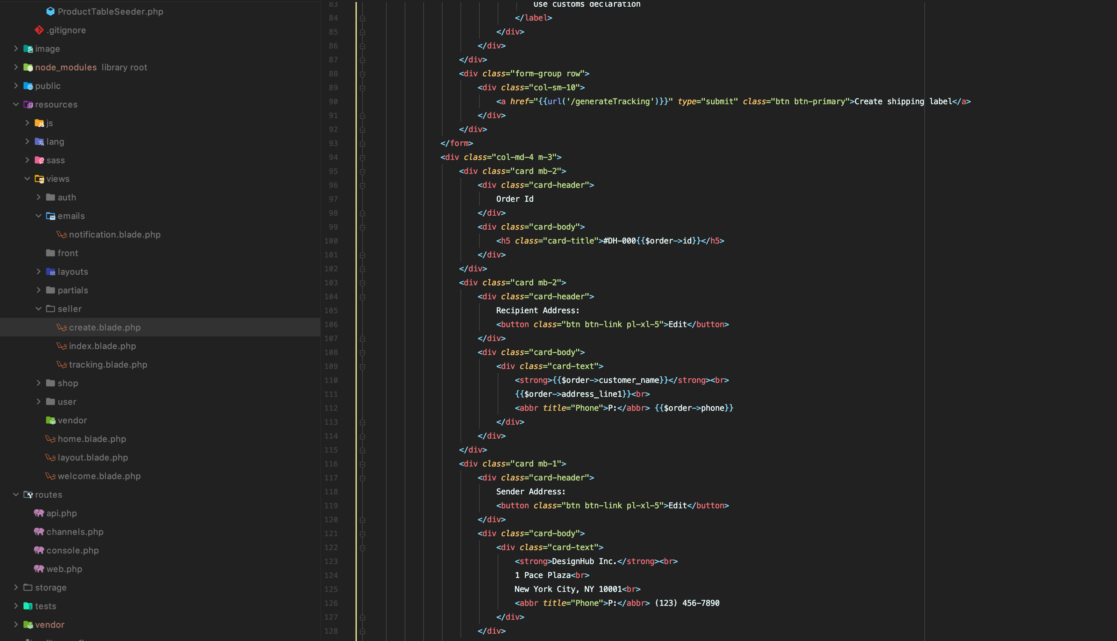
Source Code for Application – Seller view

Slide 7
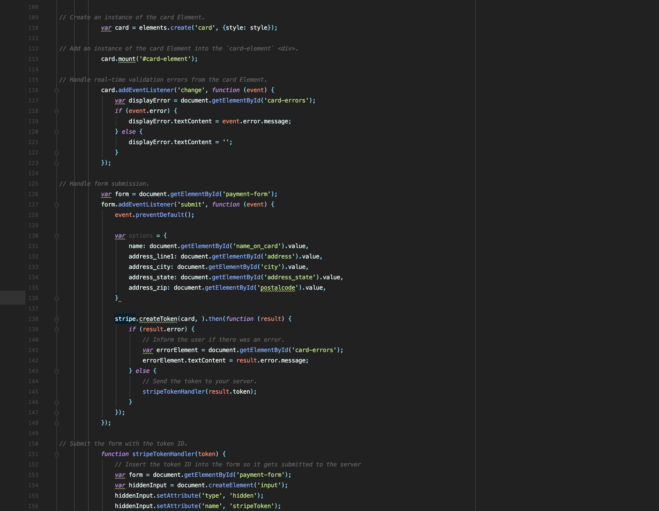
Source Code for Application – Stripe API config

Slide 8
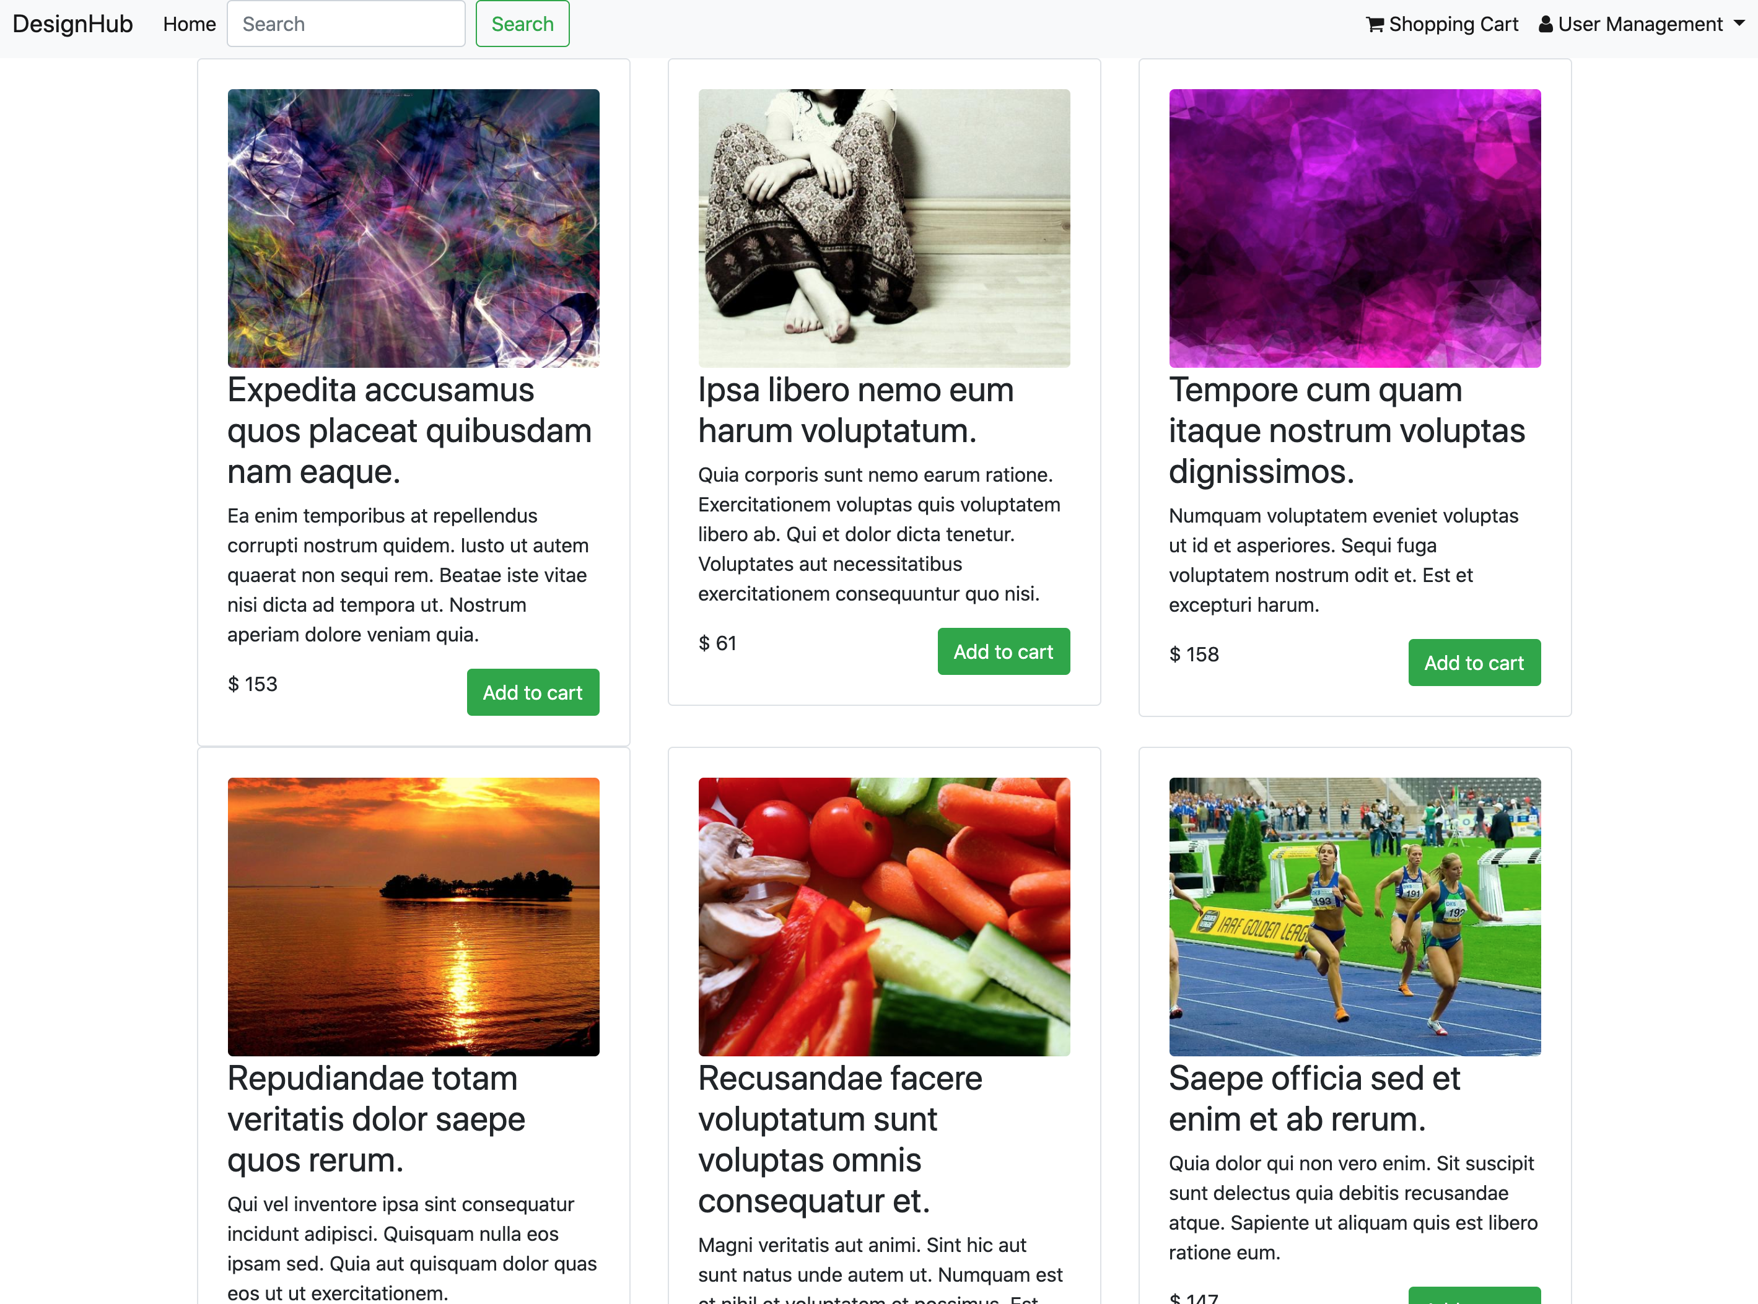
Source Code for Application – Webpage Layout

Slide 9
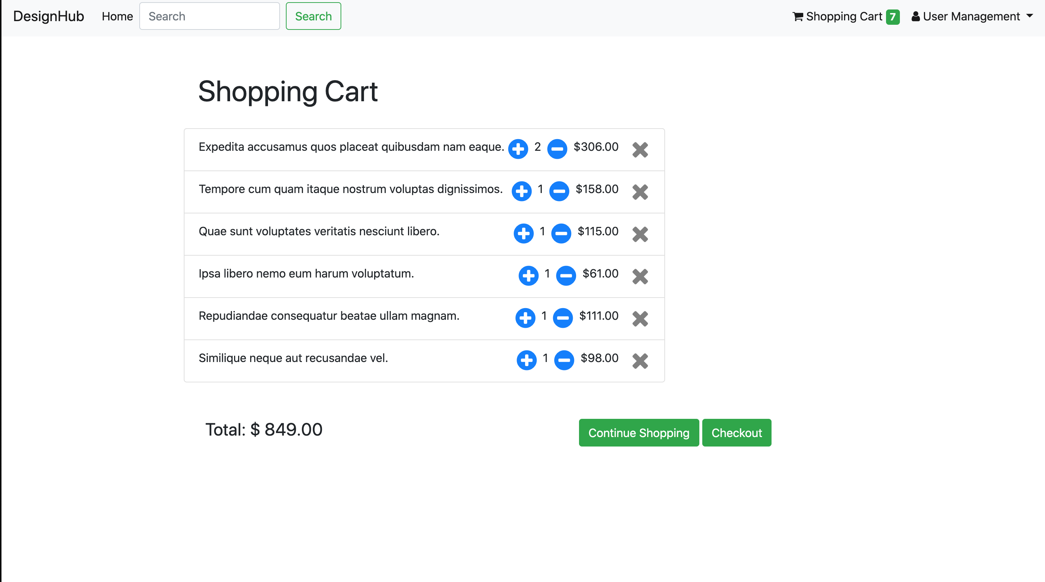
Source Code for Application – Webpage Layout

Slide 10
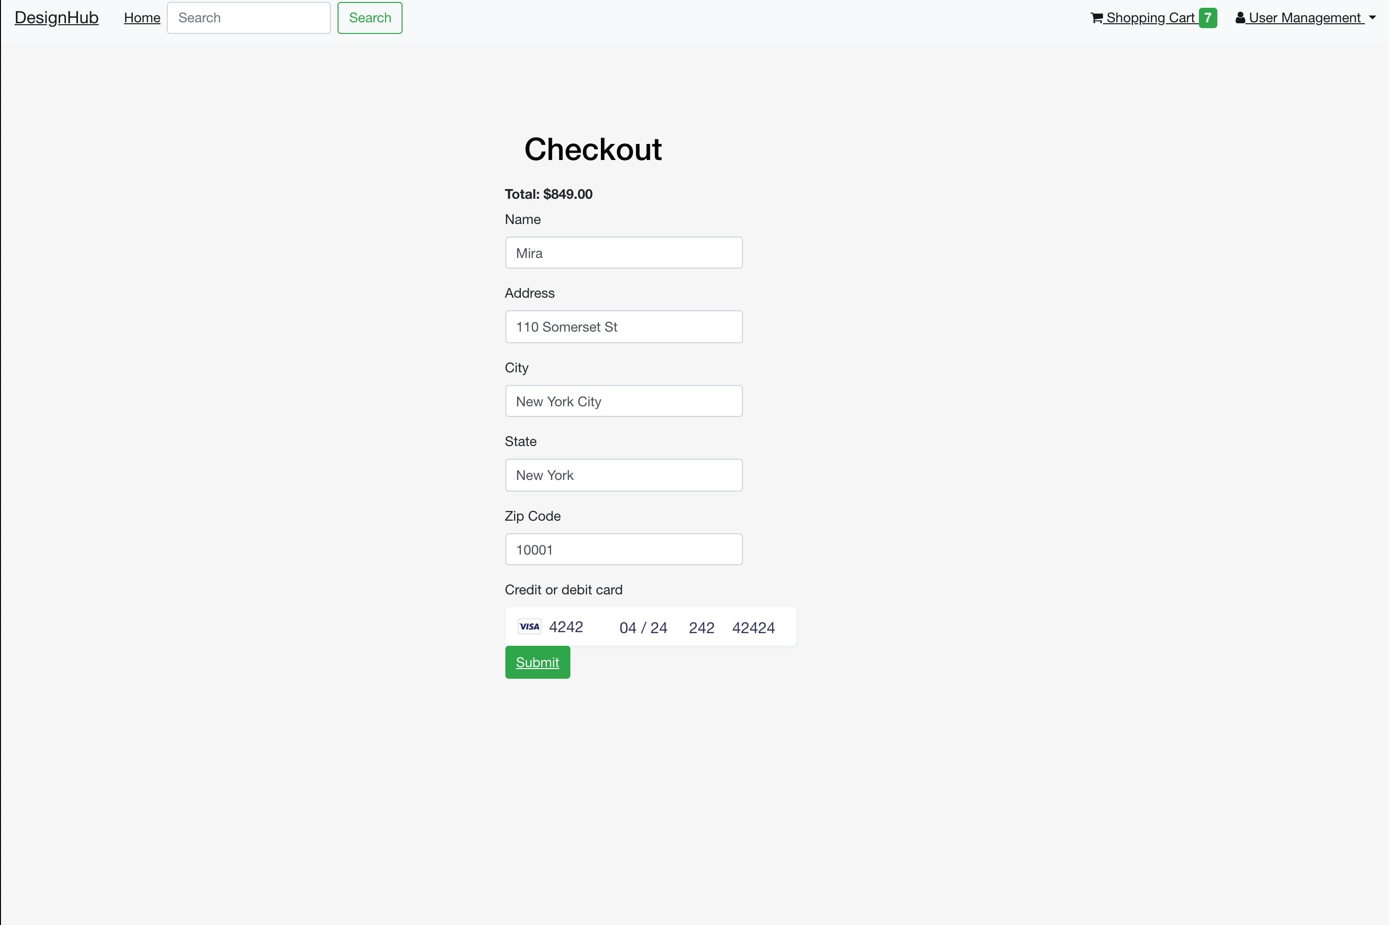
Source Code for Application – Webpage Layout

Slide 11
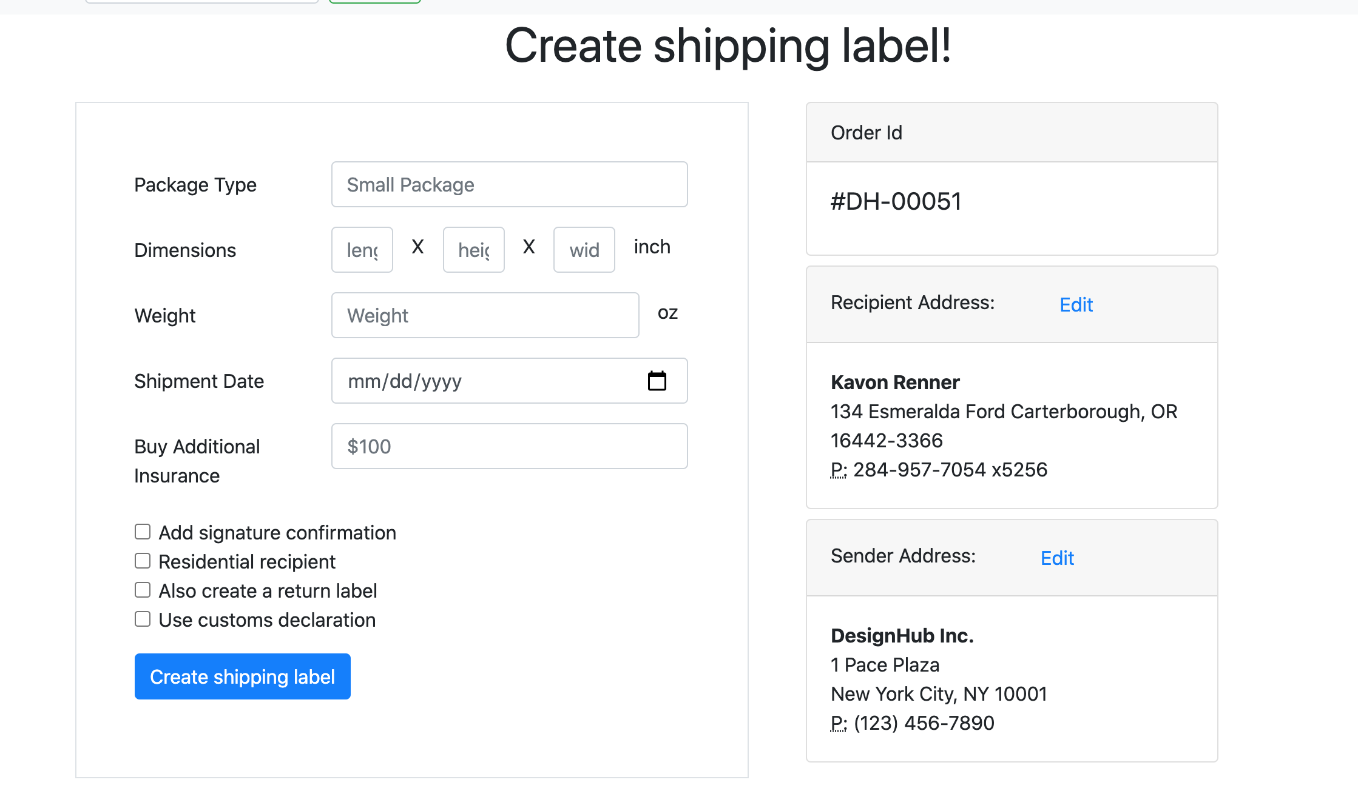
Source Code for Application – Webpage Layout

Slide 12
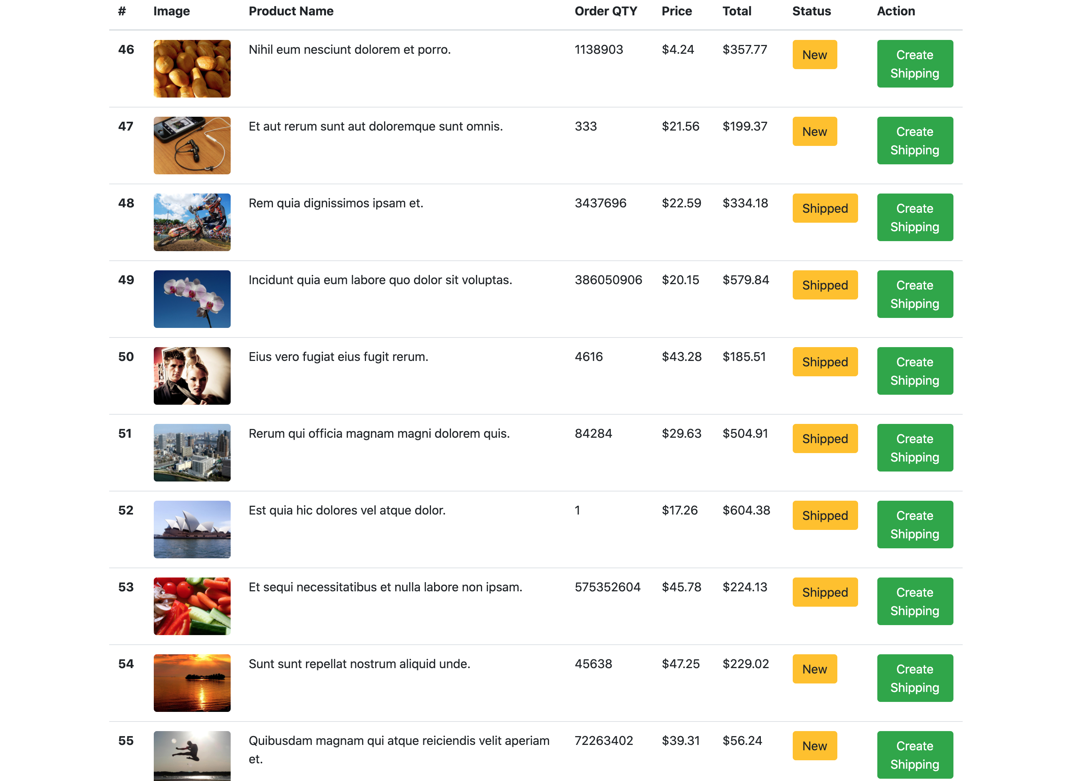
Source Code for Application – Webpage Layout

Slide 13
CS 692 - DesignHub Login & customer cart (YouTube link)
https://www.youtube.com/watch?v=xgqK5kJ85OA

